Slide 1
JavaScript the Hard Parts
JavaScript principles, Callbacks & Higher Order functions, Closure, Classes/Prototypes & Asynchronicity

Slide 2
Contents
1. Principles of JavaScript
2. Callbacks & Higher order functions
3. Closure (scope and execution context)
4. Asynchronous JavaScript & the event loop
5. Classes & Prototypes (OOP)

Slide 3
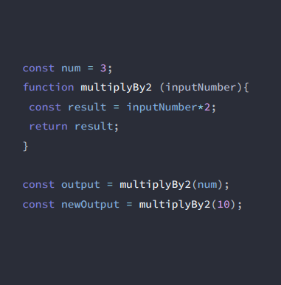
JavaScript principles
When JavaScript code runs, it:
Goes through the code line-by-line and runs/ ’executes’ each line - known as the thread of execution
Saves ‘data’ like strings and arrays so we can use that data later - in its memory

Slide 4
Execution context
Created to run the code of a function - has 2 parts (we’ve already seen them!) –
Thread of execution
Memory

Slide 5
Call stack
JavaScript keeps track of what function is currently running (where’s the thread of execution)
Run a function - add to call stack
Finish running the function - JS removes it from call stack
Whatever is top of the call stack - that’s the function we’re currently running

Slide 6
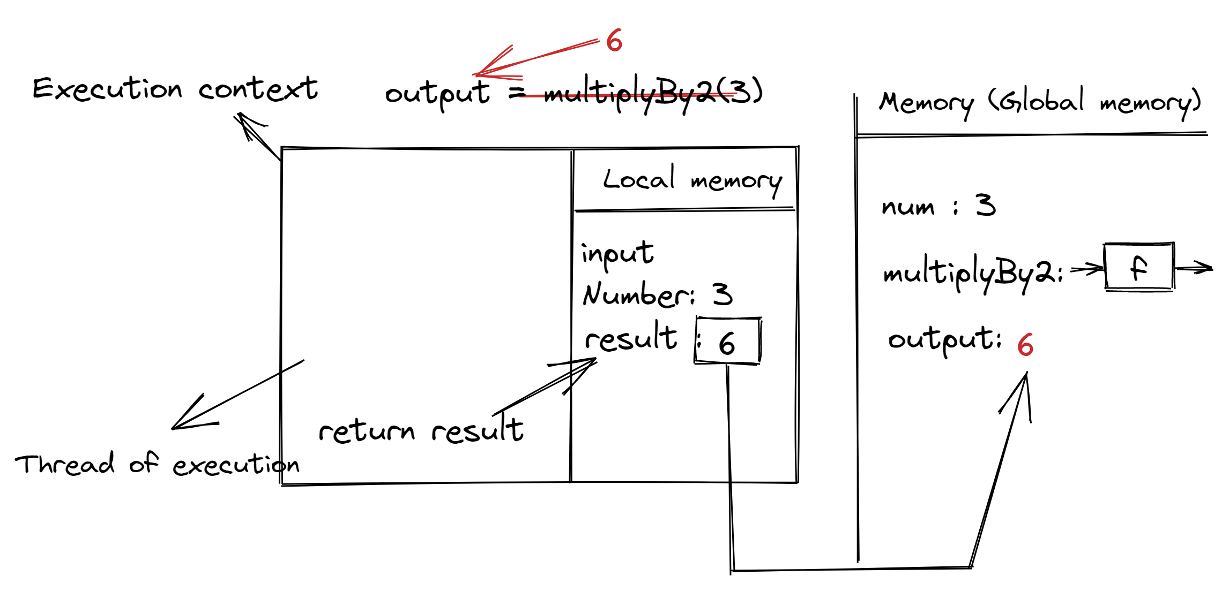
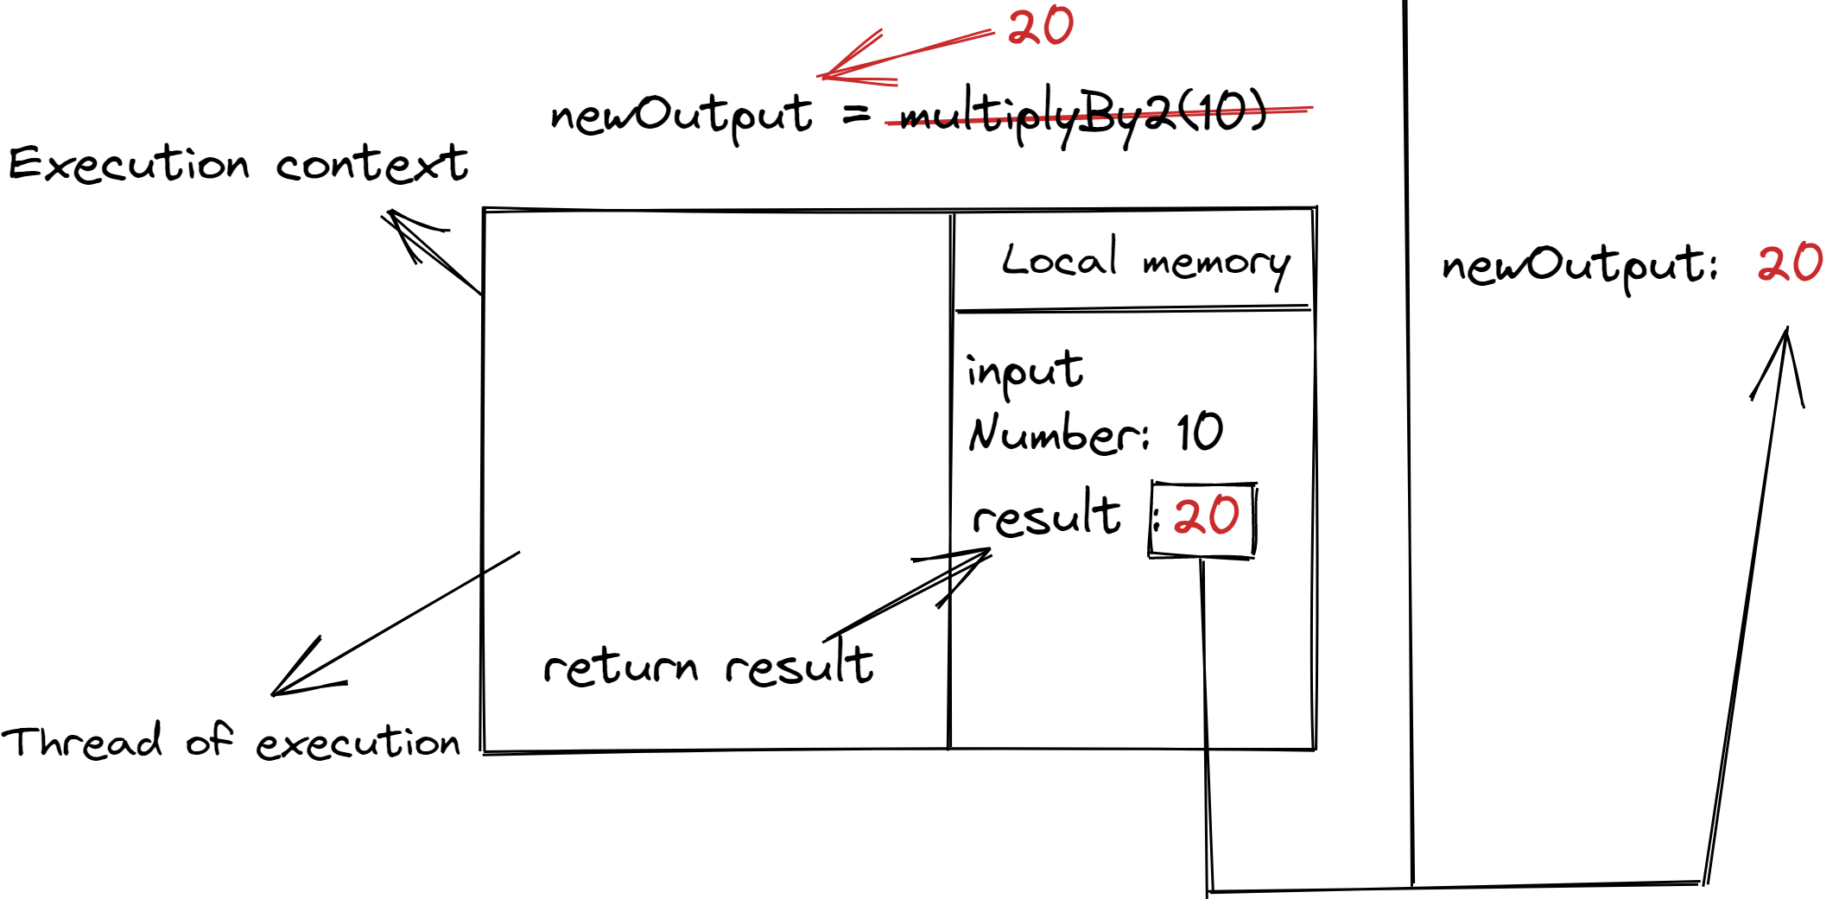

Slide 7
Contents
1. Principles of JavaScript
2. Callbacks & Higher order functions
3. Closure (scope and execution context)
4. Asynchronous JavaScript & the event loop
5. Classes & Prototypes (OOP)

Slide 8
Callbacks & Higher Order Functions
One of the most misunderstood concepts in JavaScript
Enables powerful pro-level functions like map, filter, reduce (a core aspect of functional programming)
Makes our code more declarative and readable
Asynchronous JavaScript: Callbacks are a core aspect of async JavaScript, and are under-the-hood of promises, async/await

Slide 9
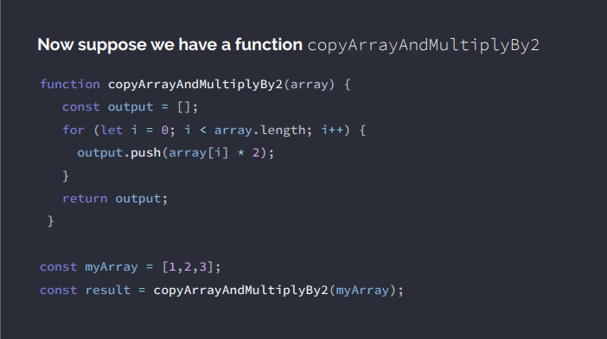

Slide 10
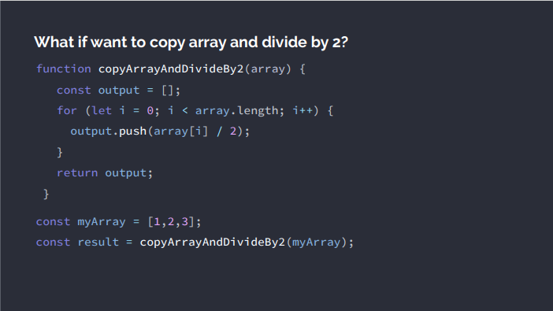

Slide 11
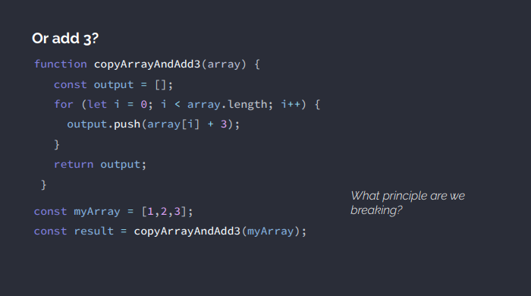
Dry - Don’t repeat yourself

Slide 12
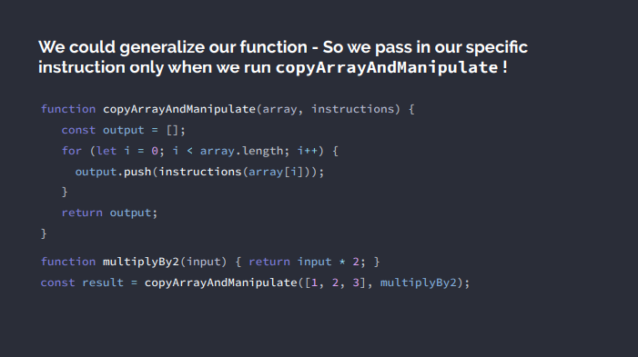

Slide 13
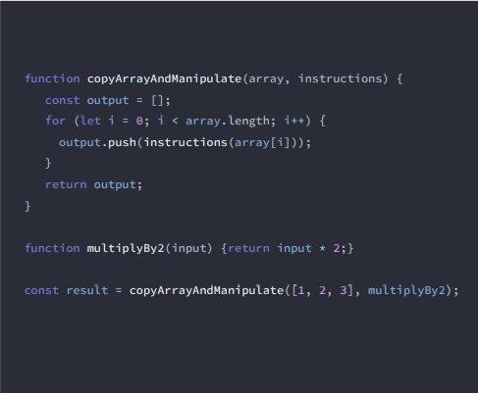

Which is our Higher Order Function?
The outer function that takes in a function is our higher-order function
Which is our Callback Function?
The function we insert is our callback function

Slide 14
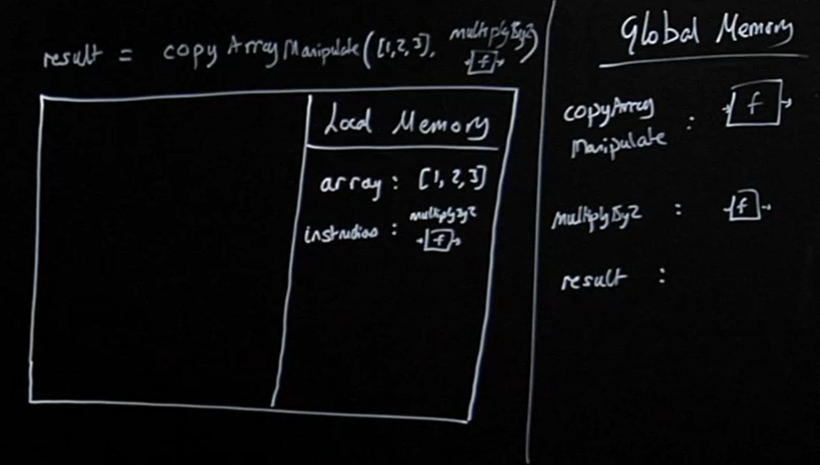
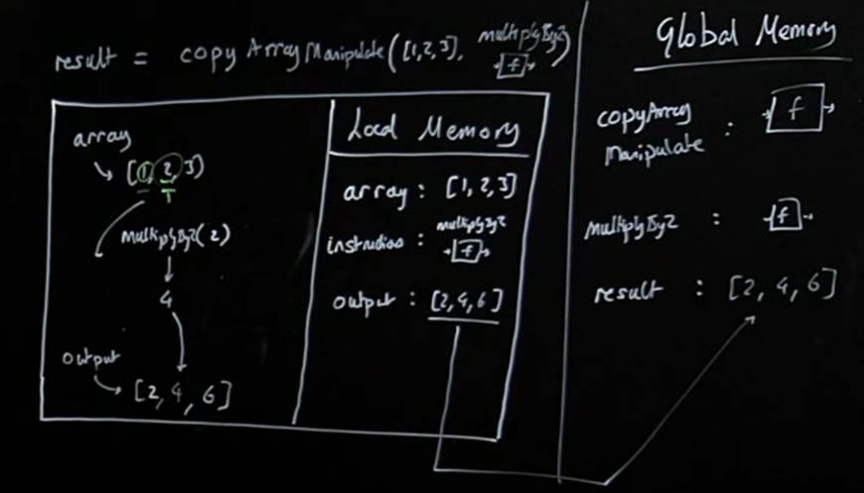
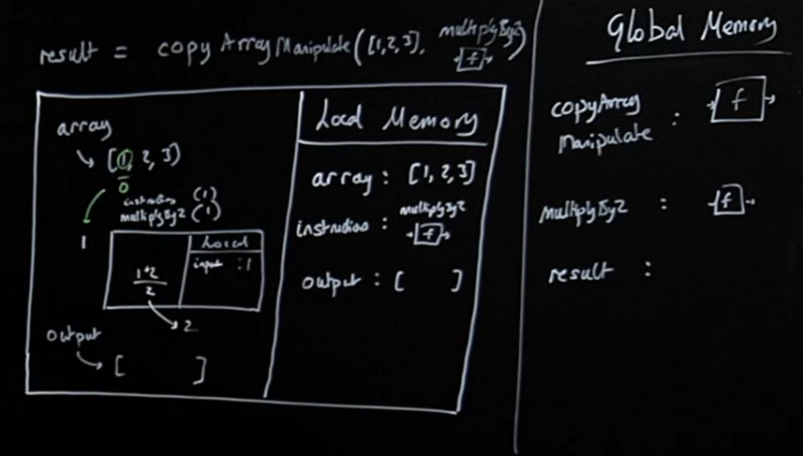
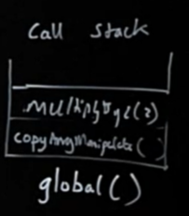
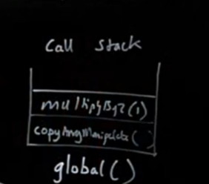
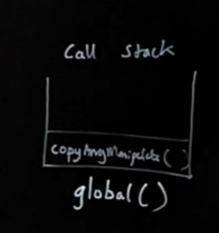

Slide 15
Functions in JavaScript = first class objects
They can be treated like any other JavaScript object
Assigned to variables and properties of other objects
Passed as arguments into functions
Returned as values from functions

Slide 16
Contents
1. Principles of JavaScript
2. Callbacks & Higher order functions
3. Closure (scope and execution context)
4. Asynchronous JavaScript & the event loop
5. Classes & Prototypes (OOP)

Slide 17
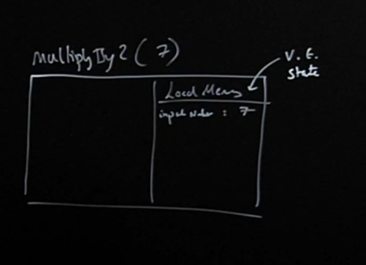
Functions with memories
When our functions get called, we create a live store of data (local memory/variable environment/state) for that function’s execution context.
When the function finishes executing, its local memory is deleted (except the returned value)
But what if our functions could hold on to live data between executions?
This would let our function definitions have an associated cache/persistent memory
But it all starts with us returning a function from another function

Slide 18
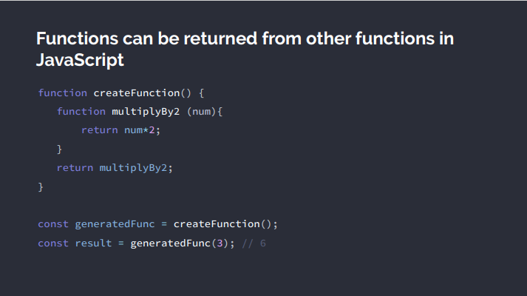
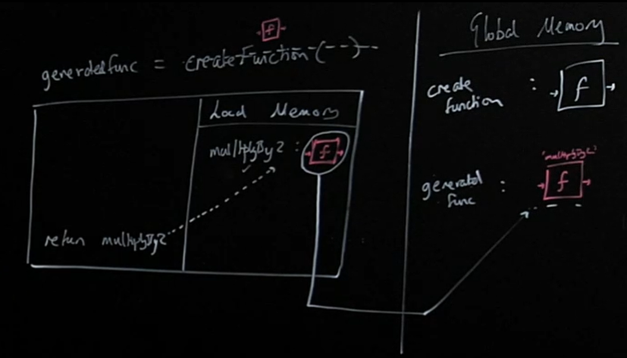
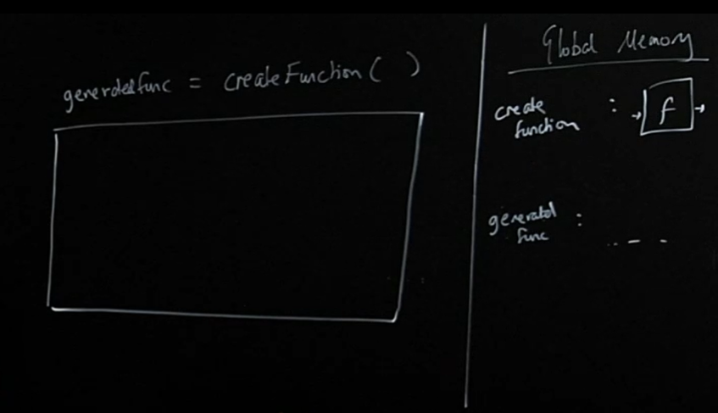
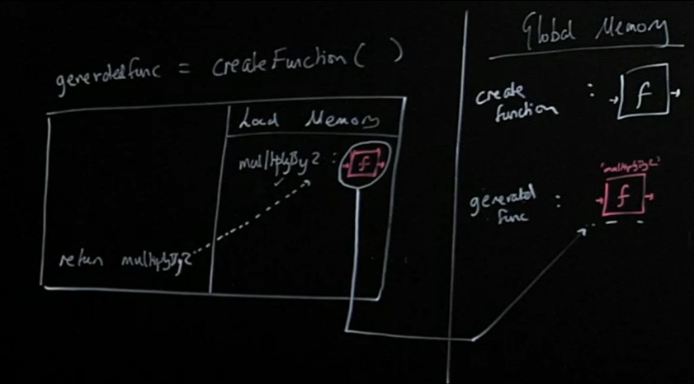
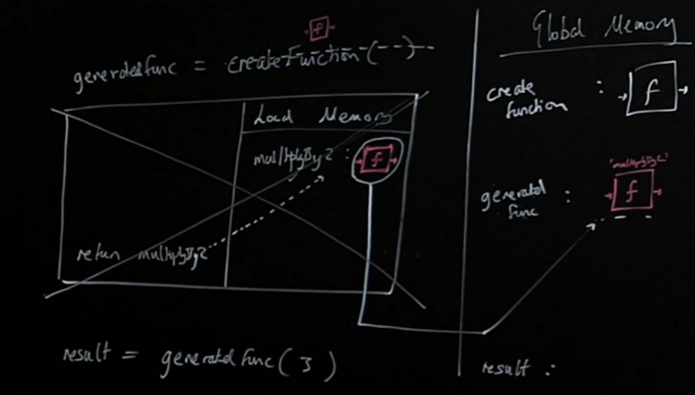
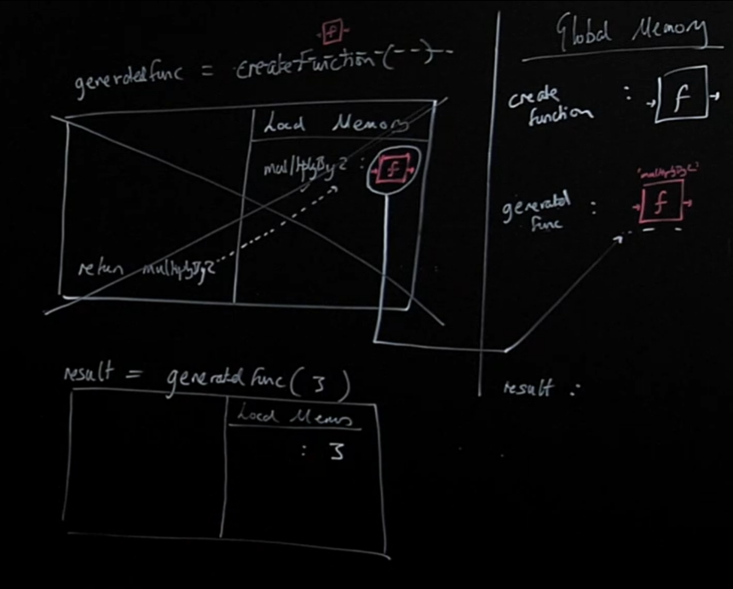
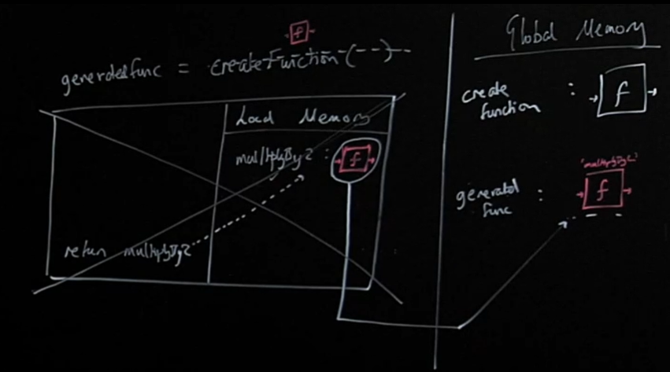
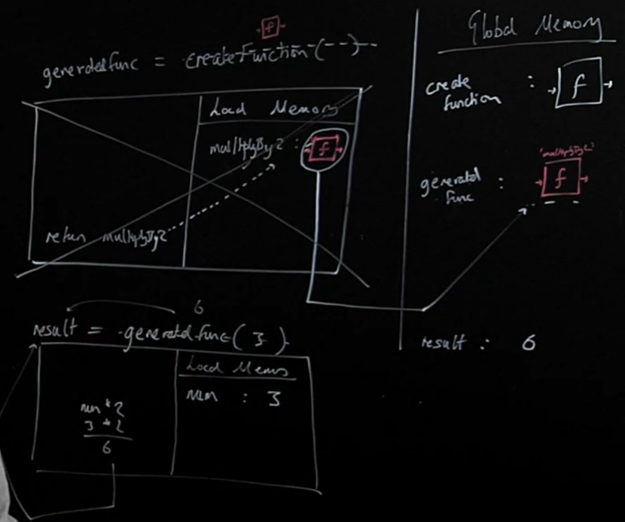

Slide 19
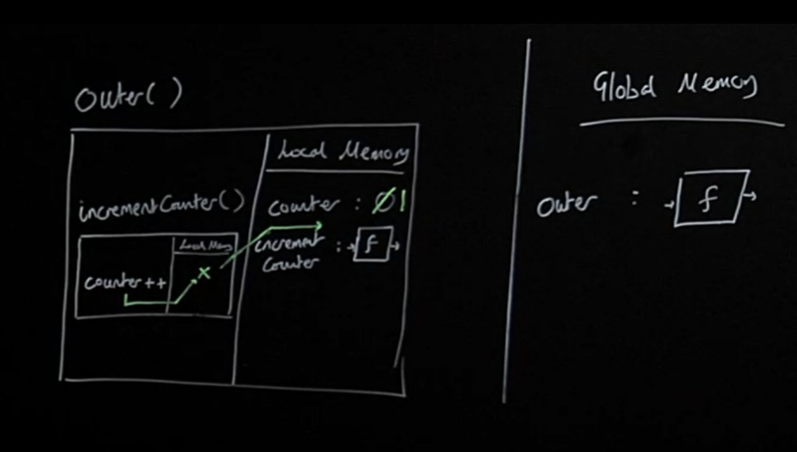
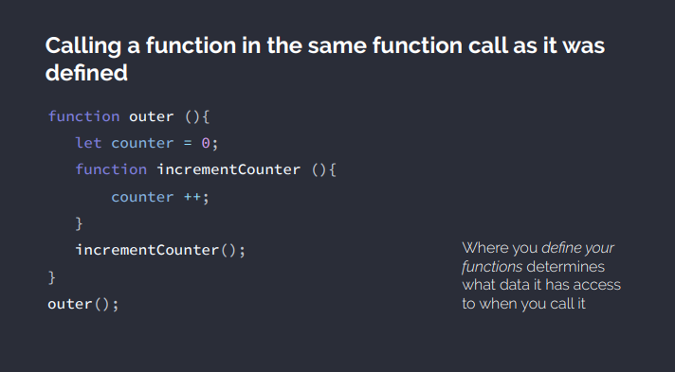
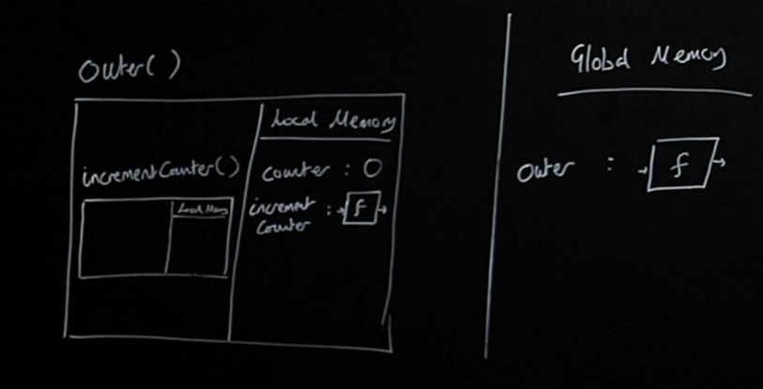
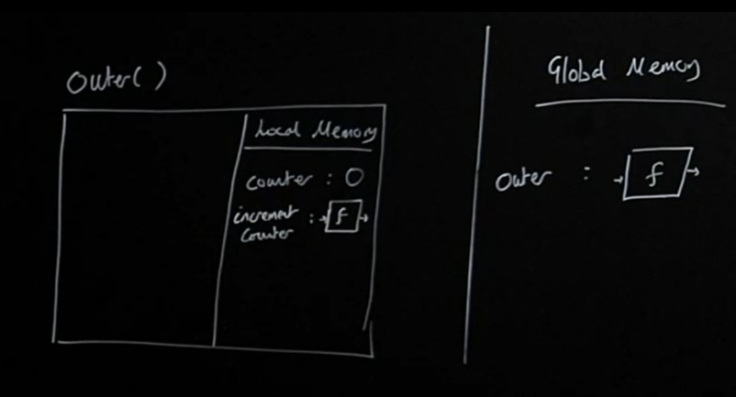
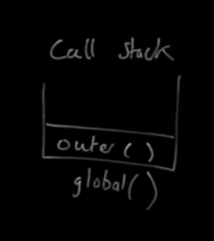
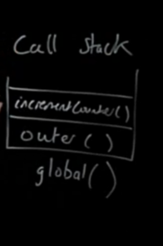

Slide 20
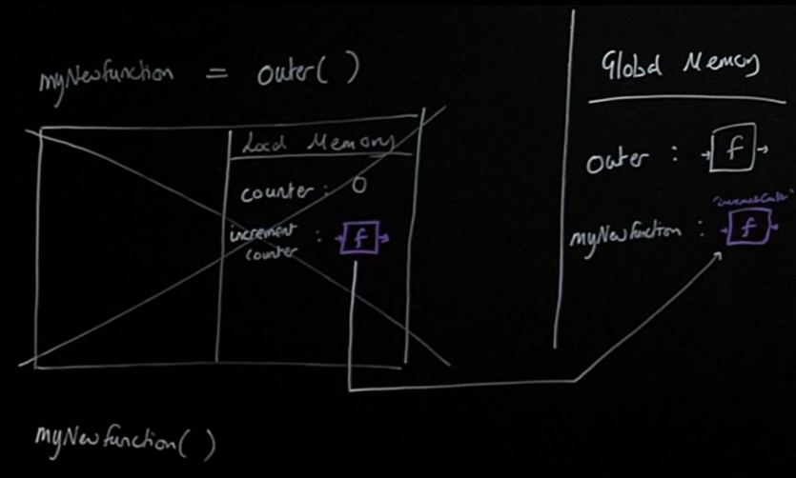
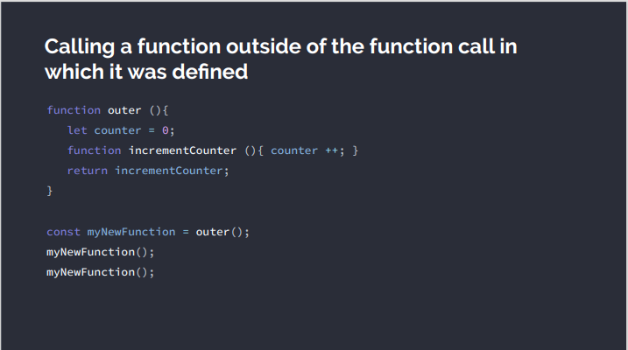
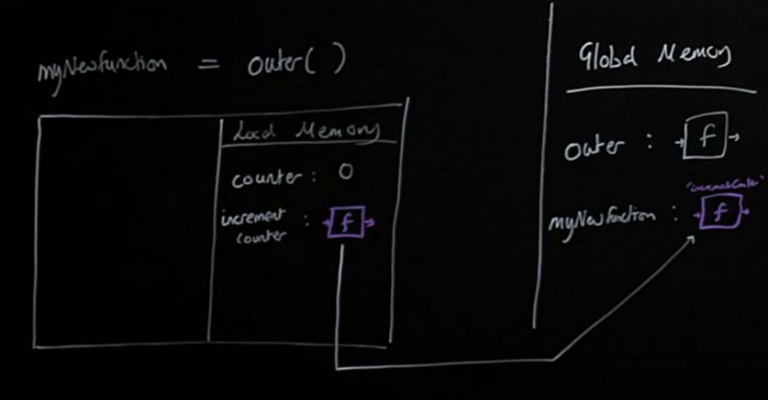
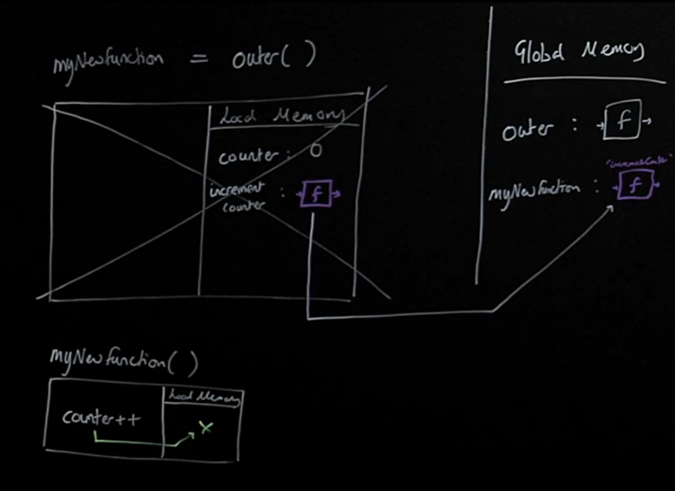
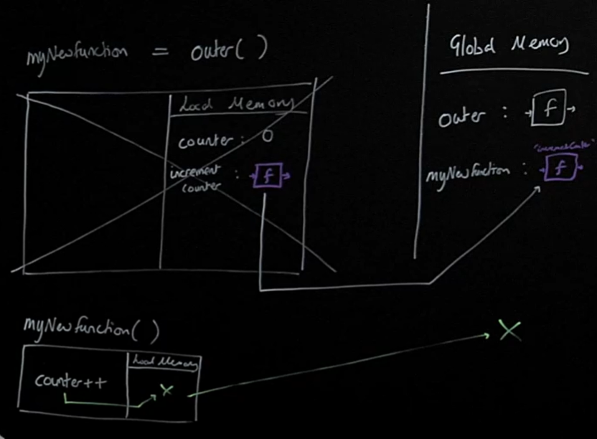
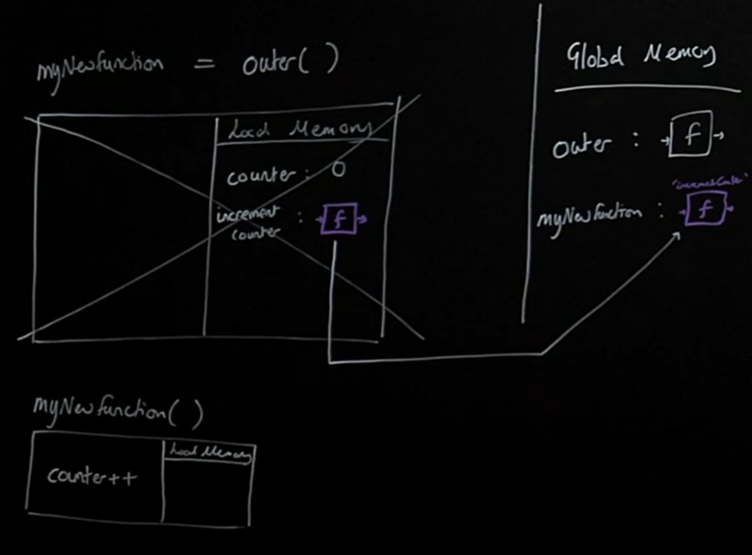
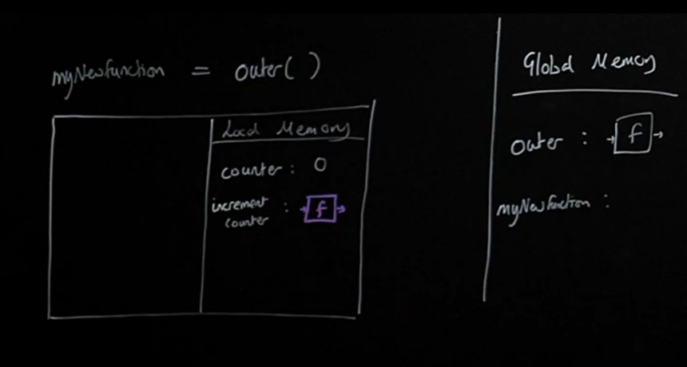
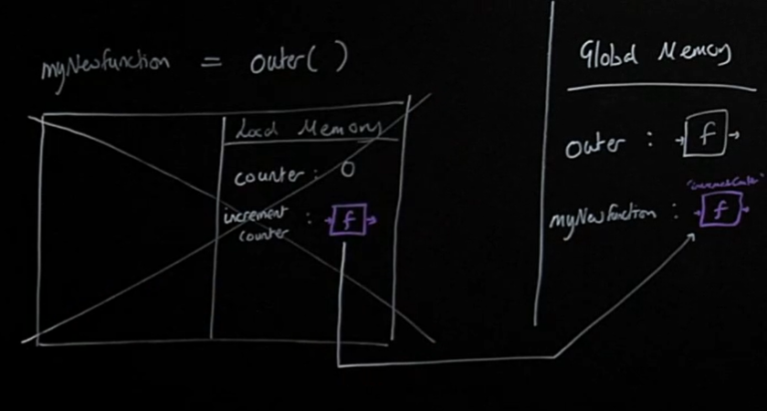
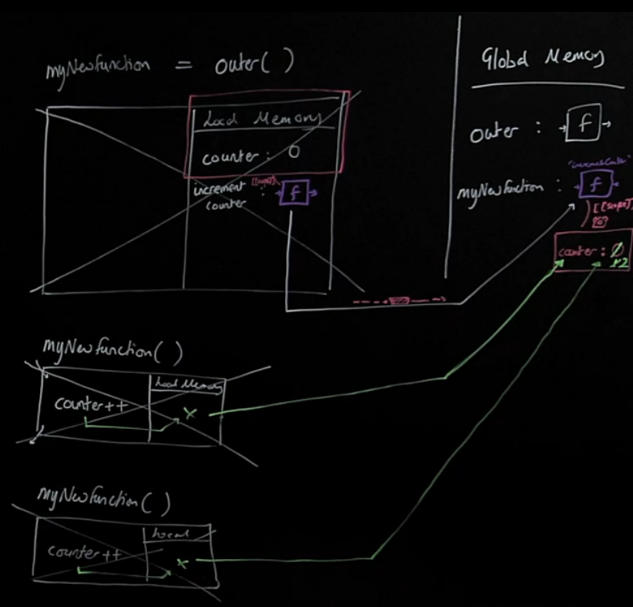
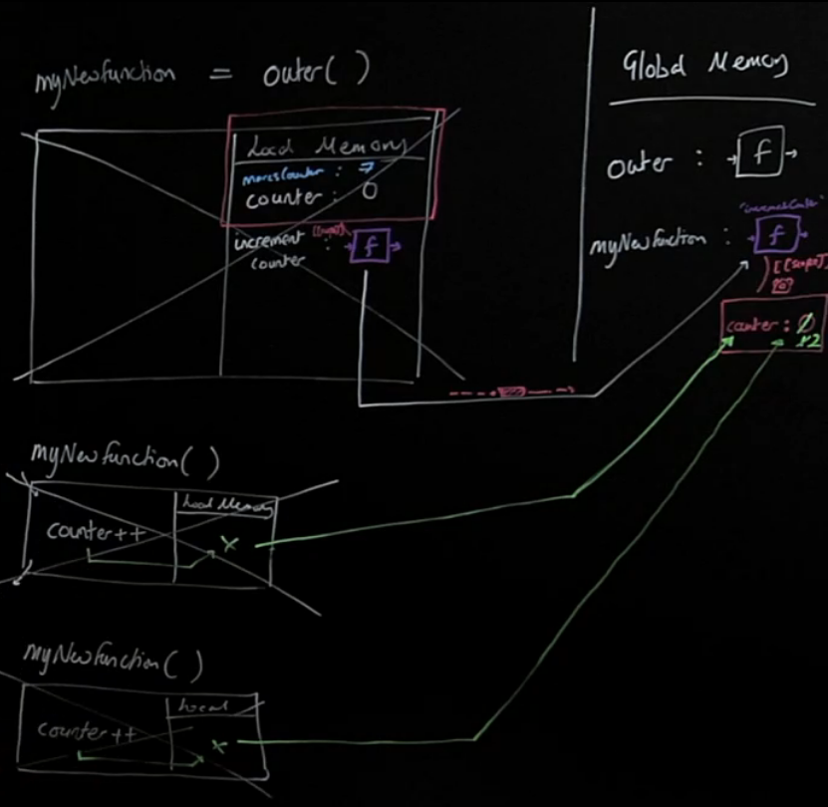
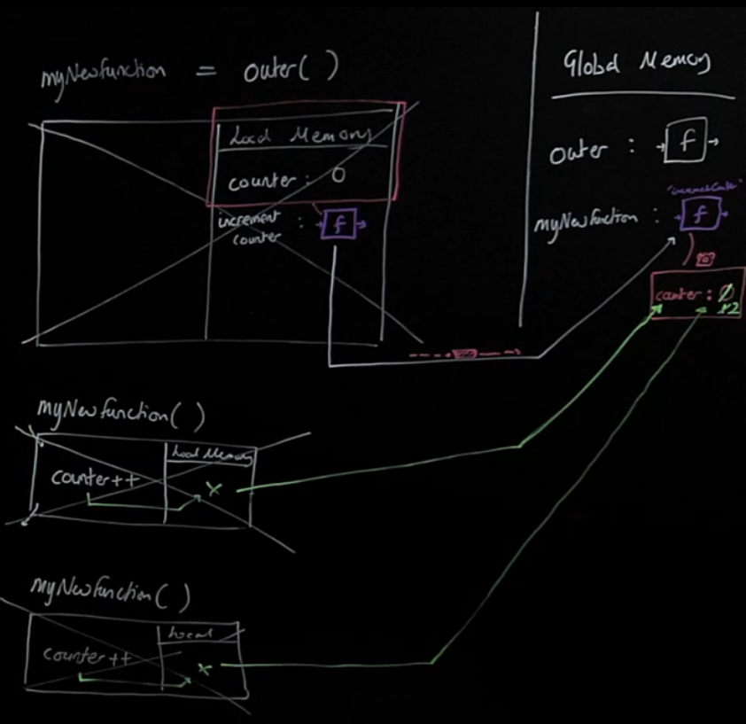
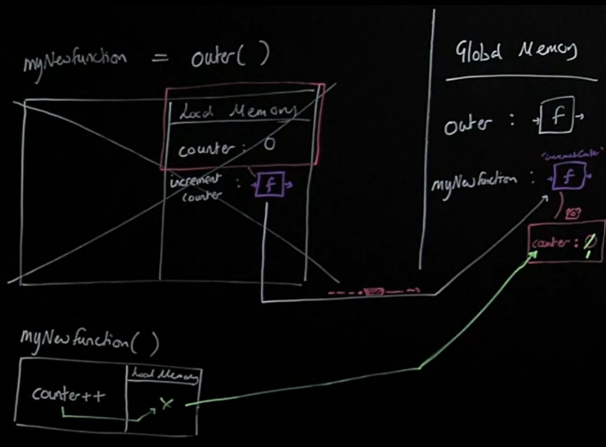
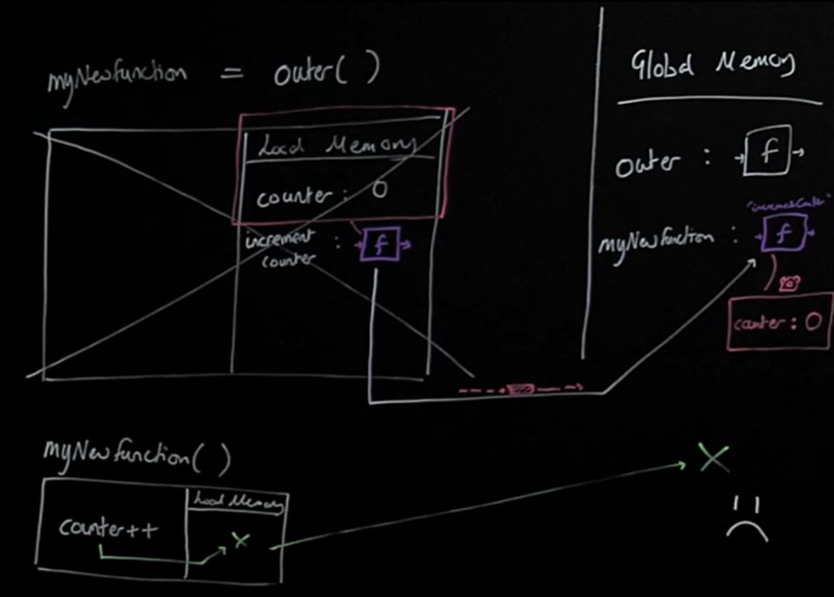
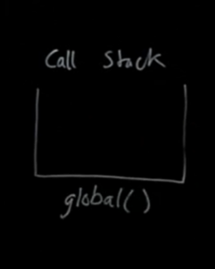
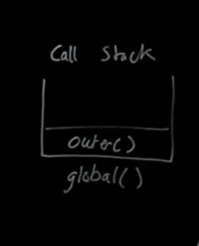
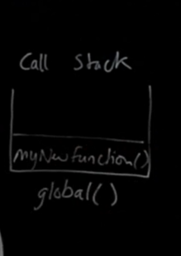

Slide 21
What is backpack called?
Closed over variables environment (C.O.V.E)
Persistent lexically or static scope reference data (P.L.S.R.D)
Closure

Slide 22
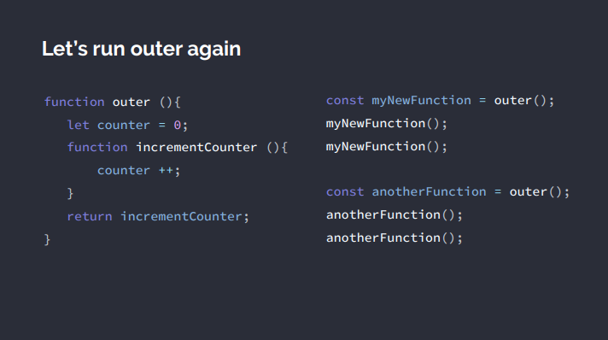

Slide 23
Closure
Helper functions: Everyday professional helper functions like ‘once’ and ‘memoize’.
Iterators and generators: Which use lexical scoping and closure to achieve the most contemporary patterns for handling data in.
JavaScript Module pattern: Preserve state for the life of an application without polluting the global namespace.
Asynchronous JavaScript: Callbacks and Promises rely on closure to persist state in an asynchronous environment.

Slide 24
Contents
1. Principles of JavaScript
2. Callbacks & Higher order functions
3. Closure (scope and execution context)
4. Asynchronous JavaScript & the event loop
5. Classes & Prototypes (OOP)

Slide 25
JavaScript is:
1. Single threaded (one command runs at a time)
2. Synchronously executed (each line is run in order the code appears)
So what if we have a task:
- Accessing Twitter’s server to get new tweets that takes a long time
- Code we want to run using those tweets

Slide 26
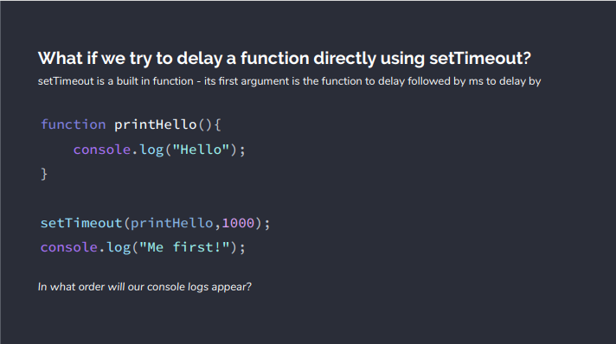

Slide 27
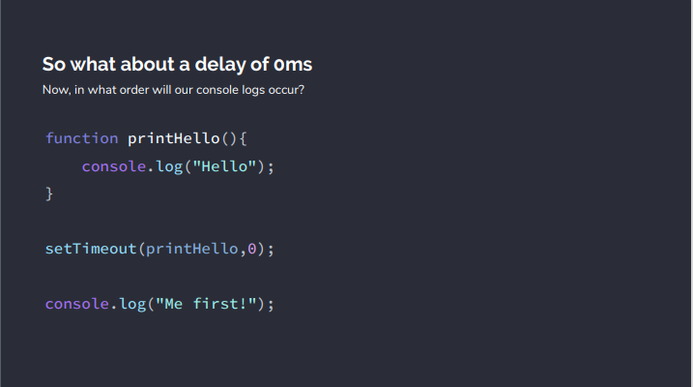
Notes:
1000000 console.log()

Slide 28
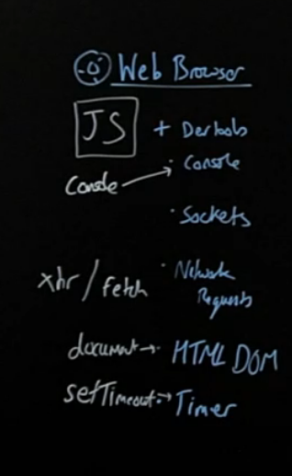
JavaScript is not enough - We need new pieces (some of which aren’t JavaScript at all)
Our core JavaScript engine has 3 main parts: -
Thread of execution
Memory/variable environment
Call stack
We need to add some new components: -
Web Browser APIs/Node background APIs
Promises
Event loop, Callback/Task queue and micro task queue
Notes:
Facade function

Slide 29
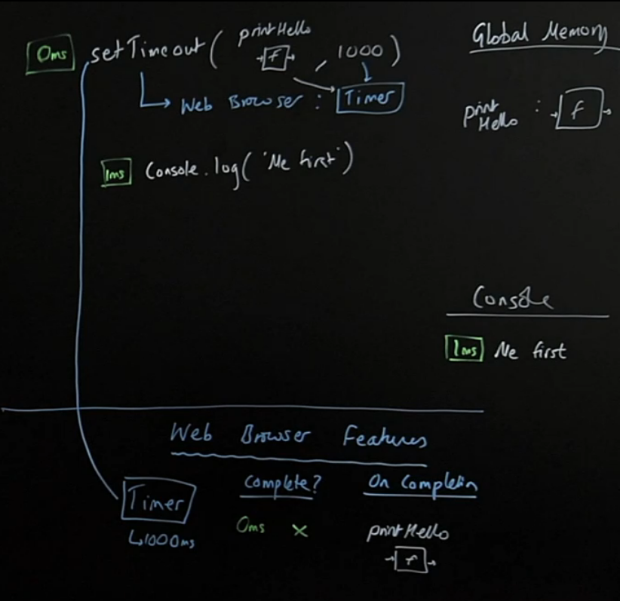





Notes:
For loop() make block for JS code

Slide 30








Notes:
All sync code, all regular execution
Event loop : Is the call stack empty?

Slide 31









Slide 32



























Slide 33
Promises, Web APIs, the Callback & Microtask Queues and Event loop enable
Non-blocking applications:
This means we don’t have to wait in the single thread and don’t block further code from running
However long it takes:
We cannot predict when our Browser feature’s work will finish so we let JS handle automatically running the function on its completion
Web applications:
Asynchronous JavaScript is the backbone of the modern web - letting us build fast ‘non-blocking’ applications

Slide 34
Contents
1. Principles of JavaScript
2. Callbacks & Higher order functions
3. Closure (scope and execution context)
4. Asynchronous JavaScript & the event loop
5. Classes & Prototypes (OOP)

Slide 35


Slide 36


Slide 37


Slide 38




This approach is completely unusable
We are storing the same function twice
Lose Space in memory
If we want to add new feature you would have to add it to each user
Where is the newUser?
Closure(Backpack) is every where

Slide 39
Solution 1. Generate objects using a function
Problems:
Each time we create a new user we make space in our computer's memory for all our data and functions.
But our functions are just copies Is there a better way?
Benefits:
It's simple and easy to reason about!

Slide 40

Solution 2: Using the prototype chain
Store the increment function in just one object and have the interpreter, if it doesn't find the function on user1, look up to that object to check if it's there
Link user1 and functionStore so the interpreter, on not finding .increment, makes sure to check up in functionStore where it would find it
Make the link with Object.create() technique

Slide 41














Implicit parameter
Notes:
In fact all functions and global automatically have a this

Slide 42
What if we want to confirm our user1 has the property score?!
We can use the hasOwnProperty method - but where is it? Is it on user1?
All objects have a __proto__ property by default which defaults to linking to a big object Object.prototype full of (somewhat) useful functions.
We get access to it via userFunctionStore’s __proto__ property - the chain.

Slide 43








Slide 44

Solution 3 - Introducing the keyword that automates the hard work: new

Slide 45



Slide 46







Notes:
Why there is no return ?

Slide 47


Solution 4: The class ‘syntactic sugar’

Slide 48
THE end, THANKS ! 😉

